Slide 1

INTERNSHIP REPORT FOR WEEK 1 AND WEEK 2
MITRE & FRAMEWORKS
-ARUN ASHOK BADRI

Slide 2
MITRE ENGAGE AND IMPLEMENTATION OF ANY ONE GOAL USING HONEYPOTS
INTERNSHIP REPORT PLAN
Month 1: Orientation and Goal Selection
Month 2: Proposal and Planning
Month 3: Implementation and Documentation

Slide 3
MITRE
WHAT IS IT ?
PROMINENT CYBERSECURITY FRAMEWORKS :
The MITRE Corporation is an American not-for-profit organization
MITRE is a government-funded research organization based in Bedford, MA, and McLean, VA.
The company was spun out of MIT in 1958 and has been involved in a range of commercial and top secret projects for a range of agencies.
MITRE has a substantial cybersecurity practice funded by the National Institute of Standards and Technology (NIST).
 | ATT&CK
 | ENGAGE
 | D3FEND
 | CALDERA

Slide 4
LET‘S DISCUSS ABOUT -
ATT&CK®
ENGAGE
MITRE Engage and MITRE ATT&CK are both valuable tools and frameworks in the field of cybersecurity, but they serve different purposes and play different roles. Let's explore the importance of each in cybersecurity:

Slide 5

MITRE ATT&CK
MITRE ATT&CK is a globally-accessible knowledge base of adversary tactics and techniques based on real-world observations of cybersecurity threats.
“the free, globally accessible service that offers comprehensive and current cyber security threat information”
- Computer Weekly
"Global knowledge base of threat activity, techniques and models"
- Tech Target

Slide 6
MITRE ATT&CK
ATT&CK stands for adversarial tactics, techniques, & common knowledge.
A - Adversary / Bad guys
Unauthorized person or a group of people
T - Tactics
refers to a high-level objective or goal that an adversary aims to achieve during a cyberattack
T - Techniques
Techniques represent the “how”—how attackers carry out a tactic in practice.
C K - Common Knowledge
This is the documented use of tactics and techniques by adversaries.

Slide 7
What is the MITRE Matrix?
The MITRE organization has developed a matrix that maps out tactics, techniques, and procedures, which can help monitor and analyze security events detected by security teams.
There are 3 ATT&CK Matrix Types -
Enterprise ATT&CK Matrix -- corporate networks
Mobile ATT&CK Matrix -- iOS and Android mobile devices
ICS(industrial control systems) Matrix -- power grids, factories, manufacturing plants, and other organizations

Slide 8
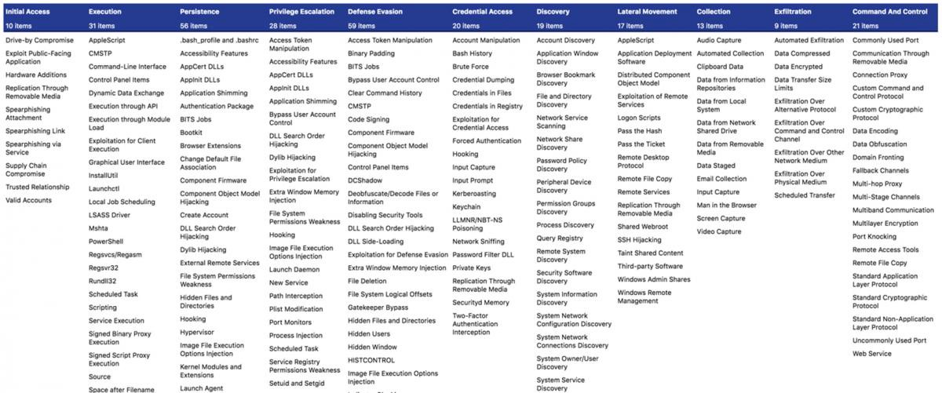
ATT&CK Matrix for Enterprise
image link : https://attack.mitre.org/

Slide 9
MITRE Matrix Use Cases -
Matrixes can be used for the following purposes :
1. Penetration testing --
Penetration testers can then use available tools to carry out specific techniques and identify if an organization is vulnerable to them.
2. Red team --
Security teams can use the Matrix to find ways to attack the organization in a training exercise.
3. Anomaly detection and threat hunting --
Associate specific indicators of compromise (IoCs) with known exploits
4. Build defensive countermeasures --
Security tools such as firewalls or intrusion detection systems (IDS) can directly consume data from the MITRE Matrix and use it to block specific malicious activities.

Slide 10
NOW LET‘S DISCUSS ABOUT -
ATT&CK
ENGAGE
MITRE Engage and MITRE ATT&CK are both valuable tools and frameworks in the field of cybersecurity, but they serve different purposes and play different roles. Let's explore the importance of each in cybersecurity:

Slide 11
MITRE ENGAGE
MITRE Engage is a knowledge base developed by the MITRE corporation, initially known as MITRE Shield. It provides ACTIVE DEFENSE information based on ten years of adversary engagement experience
To help work with the data, MITRE provides mappings that organize views. It includes a mapping between Engage and the MITRE ATT&CK® framework.
It was released in order to stimulate conversations about adversary engagement and ACTIVE DEFENSE, as well as ways in which defenders can employ active defense.

Slide 12
WHAT IS ACTIVE DEFENSE ?
Active defense involves using limited offensive counterattacks and action for the purpose of preventing enemies from intruding into a contested area or position.
ACTIVE DEFENSE = Basic cyber defensive actions + cyber deception operations + adversary engagement
These defenses enable organizations to counter attacks while also obtaining additional information about the adversary

Slide 13
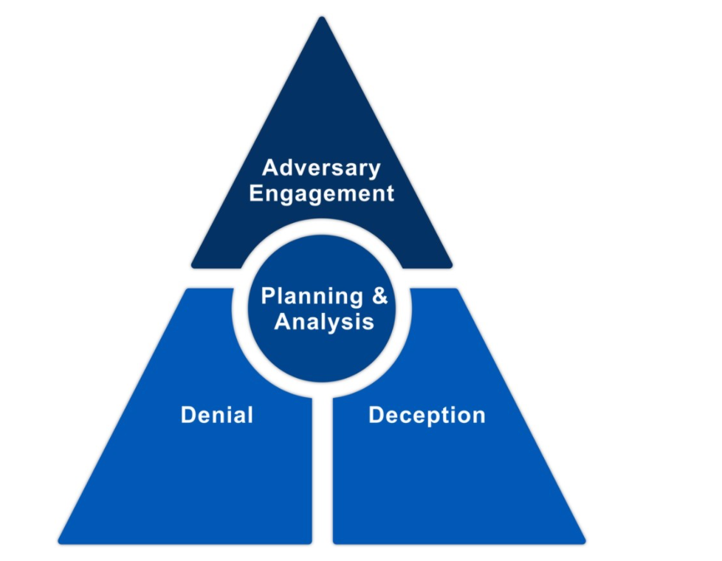
ADVERSARY ENGAGEMENT
Cyber Denial : is the ability to prevent or otherwise impair the adversary’s ability to conduct their operations. This disruption may limit their movements, collection efforts, or effectiveness of their capabilities.
Cyber Deception : intentionally reveals deceptive facts and fictions to mislead the adversary. In addition, it conceals critical facts and fictions to prevent the adversary from forming correct estimations or taking appropriate actions. When cyber denial and deception are used together, within the context of strategic planning and analysis, they provide the foundation of Adversary Engagement.

Slide 14
The MITRE Engage matrix
This model can help defenders use tactics to quickly identify the most relevant technique for each tactical objective. Defenders can use the model to build the most relevant defense solution out of the variety of Engage active defenses.
The MITRE Engage matrix illustrates the relationship between techniques and tactics. It consists of:
Tactics — the objective of defenders
Techniques — how each defense can help achieve one or multiple tactics

Slide 15
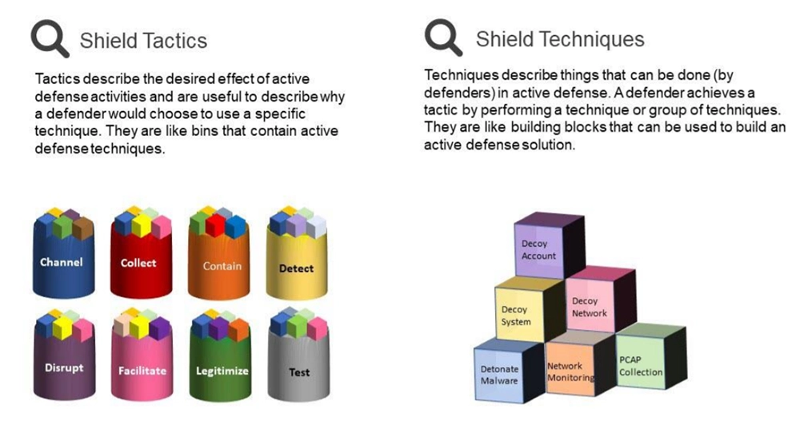

Slide 16
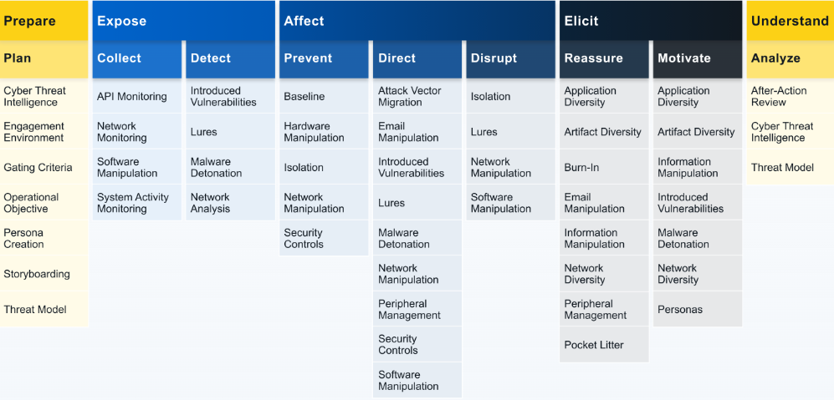
ENGAGE MATRIX

Slide 17
ENGAGE MATRIX
The Engage Matrix is broken into several components,
1. Prepare(Strategic action) -- Strategic actions ensure that defenders appropriately drive operations with strategic planning and analysis. These actions map to the Prepare and Understand phases of the 10-Step Process.
2. Expose, Affect and Elicit (Engagement action) -- Engagement actions are the traditional cyber denial and deception activities that are used to drive progress towards your objectives. These actions map to the Operate phase of the 10-Step Process.
3. Understand (S﻿trategic action)-- Strategic actions ﻿ensure that defenders appropriately drive operations with strategic planning and analysis. These actions map to the Prepare and Understand phases of the 10-Step Process.

Slide 18
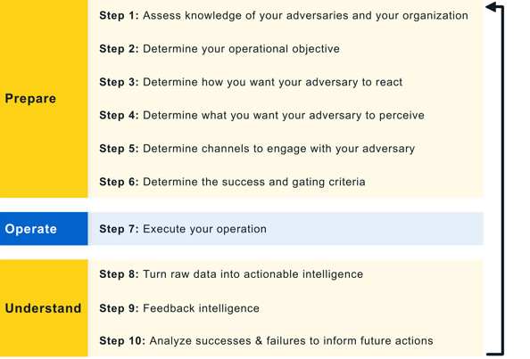
ENGAGE 10 step process

Slide 19
ENGAGE MATRIX
ENGAGEMENT OPERATIONS
1. EXPOSE (Collect & Detect) -- We can Expose adversaries on the network by using deceptive activities to provide high fidelity alerts when adversaries are active in the engagement environment.
2. AFFECT (Prevent, Direct & Disrupt) -- We can Affect adversaries by having a negative impact on their operations. Affect activities are ultimately about changing the cost-value proposition in cyber operations for the adversary.
3. ELICIT (Reassure & Motivate)-- We can Elicit information about the adversary to learn about their TTPs. By creating an engagement environment that is uniquely tailored to engage with specific adversaries, the defenders can encourage the adversary to reveal additional or more advanced capabilities.

Slide 20
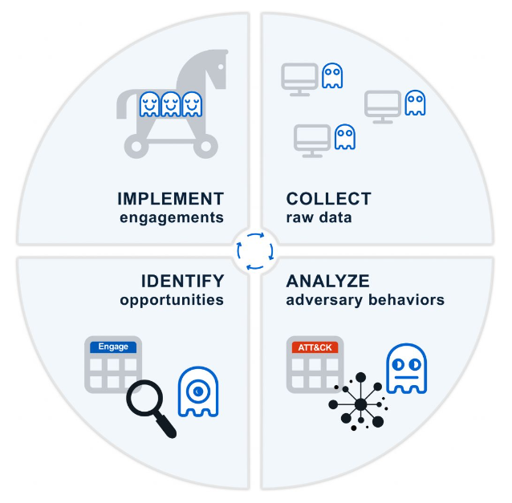
INTEGRATION OF ADVERSARY ENGAGEMENT
The MITRE Engage Cycle illustrates how the Engage Matrix can be operationalized over the course of a single operation.
collecting raw data from sensors.
2. analyzing raw data in the context of existing CTI
data.
3. identify opportunities for engagement to meet
defensive goals
4. implement your engagements

Slide 21
How Can MITRE Engage Help Your Organization?
General cyber defense -- Organizations can use MITRE Engage techniques within the corporate network to deter and detect adversaries.
Cyber deception -- Deception security, also known as the tripwire approach, proactively searches for threats. Deception systems are designed to be indistinguishable from regular production systems and are capable of serving as high-fidelity systems.
Adversary engagement -- The majority of MITRE Engage techniques are designed to help defenders collect, observe, and understand adversary activities performed against the targeted system.

Slide 22
MITRE ATT&CK vs MITRE Engage
Even though both are inter-related, a few differences can be observed -
MITRE ATT&CK focuses on the perspective of adversaries, while
MITRE Engage focuses on the perspective of defenders.
Both knowledge bases use matrices but
Engage considers defense techniques and tactics while
ATT&CK considers adversarial behaviors.
Engage offers defensive tactics that can help defenders accomplish their objectives but
ATT&CK offers a knowledge base for all the adversarial attack methods used up till now.

Slide 23
Thank
you!

